Slide 1
Chapter 5
Inside the City II: A Closer Look

Slide 2
CHAPTER OUTLINE
5.1 From Property Rent to Property Value: The Effect of Rent Growth Expectations
5.2 Effect of Uncertainty on Speculative Land Value
5.3 Let’s Get Real: New Twists to the Old Model
5.3.1 Density Variations and Heterogeneous Land Use
5.3.2 Effect of Land Use Boundaries
5.3.3 Polycentric Cities
5.3.4 Neighborhood Dynamics and Life Cycle
5.4 Property Life Cycle and the Effect of Building Structure Depreciation
5.5 Chapter Summary

Slide 3
LEARNING OBJECTIVES
After reading this chapter, you should understand:
The difference between land value and land rent and the key determinants of land values in and around a city.
Why uncertainty can result in higher land values but less land development in a city.
Why different land uses and densities occur at different locations within a city.
How neighborhoods or urban districts grow and mature and sometimes decline and rise again.
The concept of property life cycle and its implications for real estate investors.
The nature and cause of the major characteristics of urban form and how this can evolve.

Slide 4
5.1 From Property Rent to Property Value: The Effect of Rent Growth Expectations

Slide 5
5.2 Effect of Uncertainty on Speculative Land Value

Slide 6
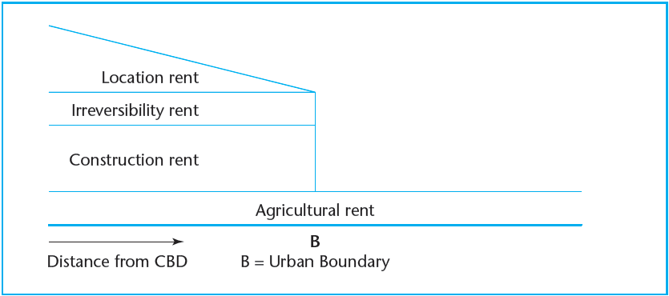
EXHIBIT 5-1 Components of Property Rent Outside and Inside the Urban Boundary, Under Uncertainty
Copyright © 2021 Mbition LLC. All rights reserved.

Slide 7
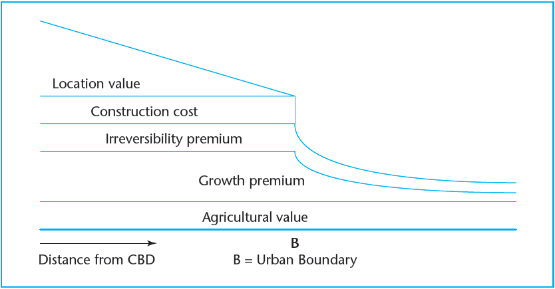
EXHIBIT 5-2 Components of Property Value Outside and Inside the Urban Boundary, Under Uncertainty
Copyright © 2021 Mbition LLC. All rights reserved.

Slide 8
5.3 Let’s Get Real: New Twists to the Old Model

Slide 9
5.3.1 Density Variations and Heterogeneous Land Use

Slide 10
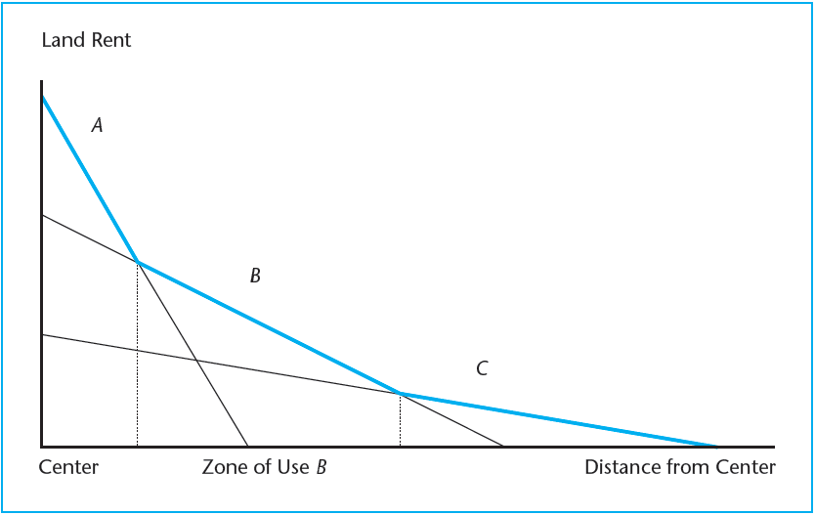
EXHIBIT 5-3 Bid-Rent Functions of Three Land Uses with Differing Productivity and Sensitivity to Transport Cost
Copyright © 2021 Mbition LLC. All rights reserved.

Slide 11
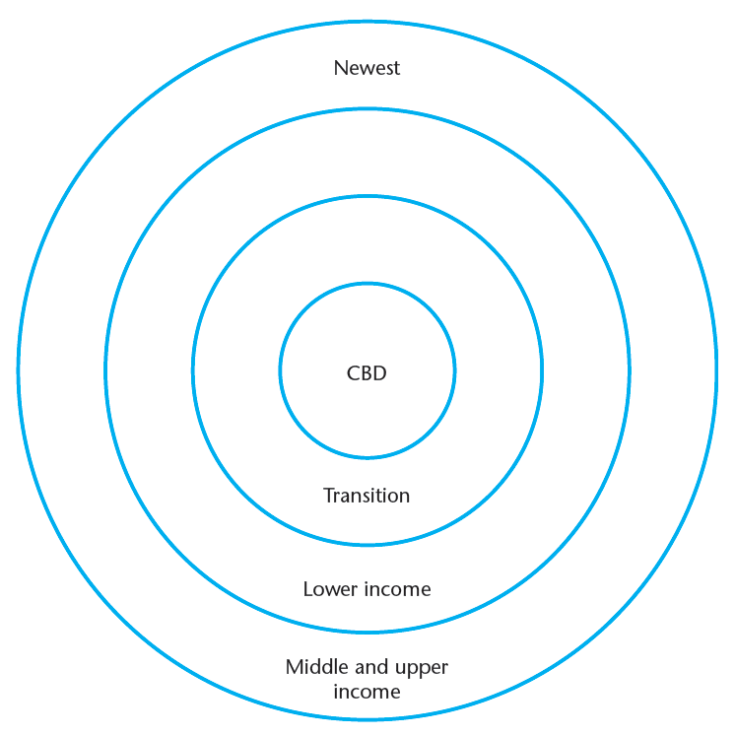
EXHIBIT 5-4 Concentric Ring Model of Urban Land Use Structure (Burgess)
Copyright © 2021 Mbition LLC. All rights reserved.

Slide 12
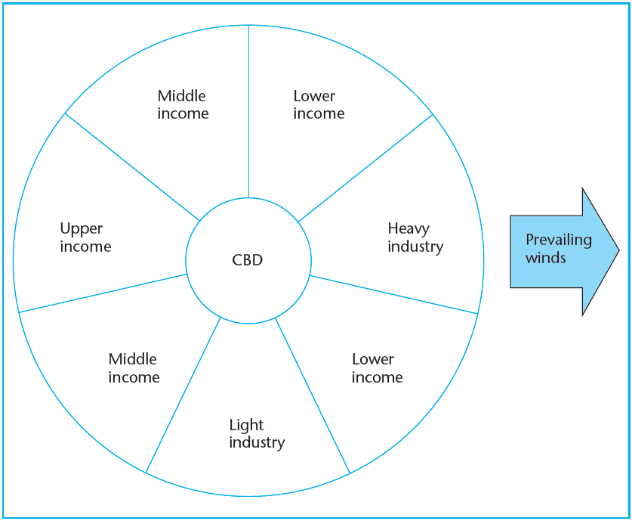
EXHIBIT 5-5 Sector Model of Urban Land Use Structure (Hoyt)
Copyright © 2021 Mbition LLC. All rights reserved.

Slide 13
5.3.2 Effect of Land Use Boundaries

Slide 14
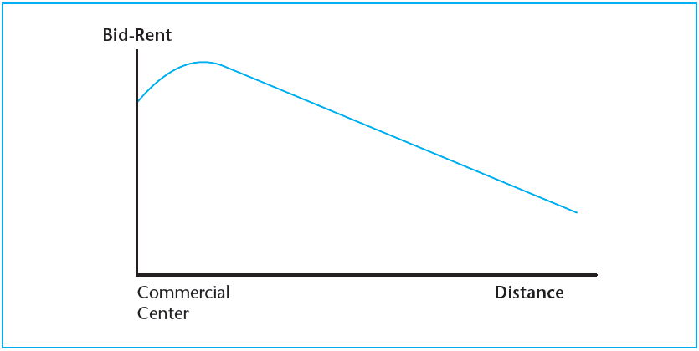
EXHIBIT 5-6 Effect of Negative Externalities Near a Land Use Boundary
Copyright © 2021 Mbition LLC. All rights reserved.

Slide 15
5.3.3 Polycentric Cities

Slide 16
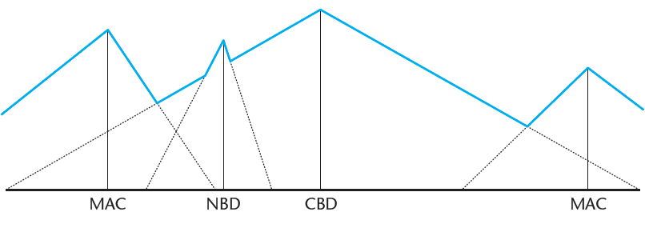
EXHIBIT 5-7 Rent Gradients in a Polycentric City
Copyright © 2021 Mbition LLC. All rights reserved.

Slide 17
5.3.4 Neighborhood Dynamics and Life Cycle

Slide 18
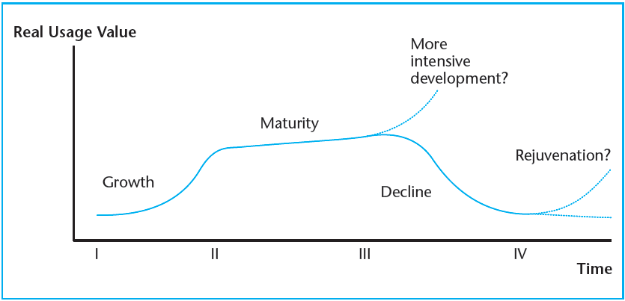
EXHIBIT 5-8 Neighborhood Succession Model
Copyright © 2021 Mbition LLC. All rights reserved.

Slide 19
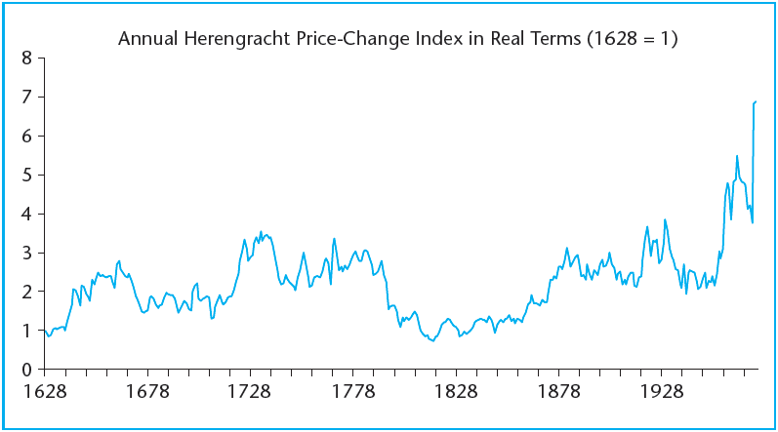
EXHIBIT 5-9A Herengracht Usage Value Index, 1628–1974
Source: Eichholtz and Geltner (2004).

Slide 20
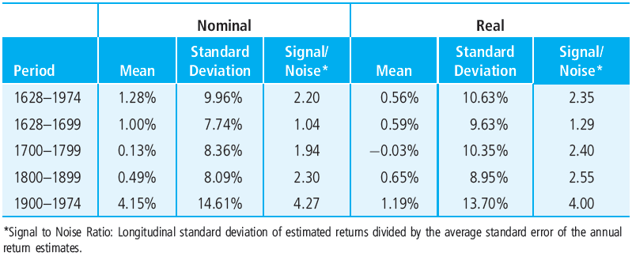
EXHIBIT 5-9B Summary Statistics of Herengracht Annual Repeat-Sale Price-Change Index
Source: Eichholtz and Geltner (2004).

Slide 21
5.4 Property Life Cycle and the Effect of Building Structure Depreciation

Slide 22
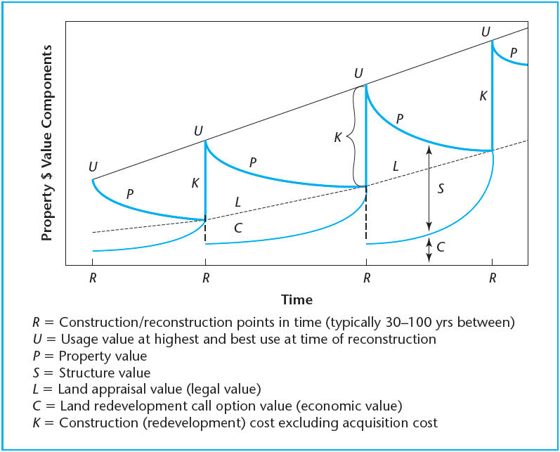
EXHIBIT 5-10 Components of Property Value over Time
Copyright © 2021 Mbition LLC. All rights reserved.

Slide 23
5.5 Chapter Summary

Slide 24
EXHIBIT 5-1: <<insert>>
Copyright © 2021 Mbition LLC. All rights reserved.

Slide 25
KEY TERMS
growth premium
irreversibility premium
concentric ring model of urban form
sector model of urban land use
compatible land uses
negative locational externality
polycentric city
major activity center (MAC)
neighborhood business district (NBD)
polynuclear city
neighborhood succession theory
property life cycle
structure value
physical obsolescence
functional obsolescence
economic obsolescence
land value
redevelopment option value
structural depreciation

